Slide 1
Jenna Estates March 21, 2023
Annual HOA Meeting

Slide 2
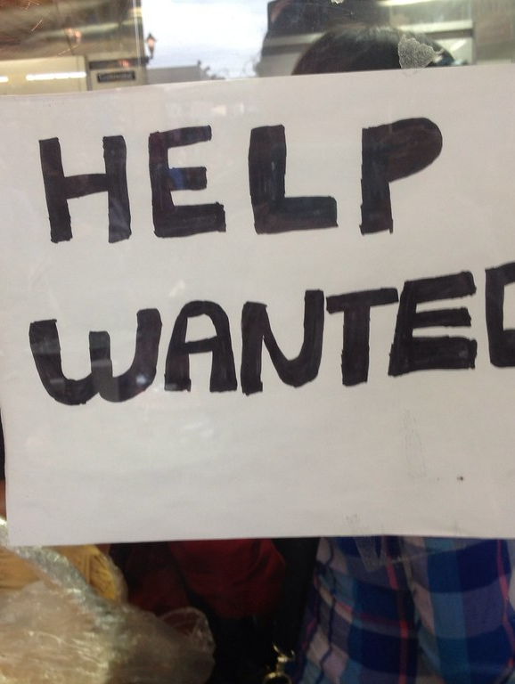
Opportunities & Open Positions
Vice President
Social Committee Chair
President (Jan 2024)
Treasurer (Jan 2024)
This Photo by Unknown Author is licensed under CC BY

Slide 3
2022 HOA Completed Projects
Replaced approximately 100’ of sidewalk along Victory Hills Way and 70’ of sidewalk along Prothero ($12,400)
Planted ornamental grass along the path to the tot lot and several new trees

Slide 4
Financial Review
In 2024, annual dues will increase 10% ($175/quarter) as a result of higher fees for Lawn Maintenance due to increased labor rates, fuel costs and inflation.

Slide 5
2023 Key Dates
Yard Waste: Collected every other week on Thursday
Begins April 13th
Ends December 7th
Pick up will be shifted one day due to holidays
July 4th week – pick up on Friday, July 7th
Thanksgiving week – pick up on Friday, Nov 24th
Bulk Trash: Collected twice a year
Saturday, April 29th
Saturday, Sept 23rd
For more detailed information, please visit the Trash page on the website: https://jennaestates.weebly.com/trash.html

Slide 6
2023 HOA Planned Projects
Reserve Study ($1,800)
The state of Maryland recently passed a mandate (house bill 107) that every HOA and Condo Association in the state complete a reserve study before October 2023 if they have not completed one in the last three years.
A reserve study evaluates the Association-owned land and elements to determine a deferred maintenance/replacement schedule and provides a financial projection for the annual reserves account to be able to handle these expenses.
The mandate requires that each Association’s reserve account be caught up to the financial schedule prescribed in the respective study within three years of the study’s completion.
The state also mandates each Association obtain a new reserve study every five years to guide reserve fund savings and element repair/replacement.
Tot Lot (Spring)
Repaint lines on basketball court
Refresh mulch

Slide 7
Social Committee: 2023 Plans
THANK YOU Bethany Brisentine for volunteering and leading our
Easter Egg Hunt / Spring Fling 2023
Sunday, April 2nd, 4:00 - 6:00 PM at the Tot Lot
(rain date Sunday April 16th, same time)
Includes pizza, an egg hunt, crafts, bubble station, and sidewalk chalk for the kids to enjoy.
We are also asking for volunteers to help with setup as well as provide folding tables, beverages/kid-friendly drinks, etc.
Details are in Signup Genius Link - Please RSVP by March 25th.

Slide 8
Social Committee: 2023 Plans
Other Planned Events:
Kona Ice Truck – June 15th (Thank you Chris Karper!)
Future events to be planned by a new Social Committee or individual event volunteers:
Fall Party / Halloween Costume Parade – October
No events will be planned unless there are volunteers

Slide 9
HOA Proxies and Voting
HOA Board Member and Committee Chair
Vice President Open
Social Committee Chair Open
Change/Amend By-Laws
N/A
HOA Dues Increase (by more than 10%)
N/A
Special Assessments (For reasons other than damaged common area property, not covered by insurance)
N/A

Slide 10
Questions
Please consider volunteering for a position:
Vice President (currently open)
Social Committee Chair (currently open)
President (available Jan 2024)
Treasurer (available Jan 2024)
Visit the HOA Website: jennaestates.weebly.com
Contact the HOA Board: JennaHOA@gmail.com
Visit the Tidewater Property Management Website: http://www.tidewaterproperty.com/

Slide 11
About the HOA
Jenna Estates Homeowners Association, Inc. (HOA)
Legal Entity – Nonprofit Corporation
Est. 2001
HOA Purpose
Preserve value and amenities in the community
HOA Board Purpose
Collection and Disbursement of HOA Dues
Maintenance and Administration of Common Areas
Enforcement of Covenants and Restrictions, and By-Laws
HOA Website: jennaestates.weebly.com
HOA Email: JennaHOA@gmail.com

Slide 12
HOA Board and Committee Members
HOA Board
President: Alyssa Neumann
Treasurer: Mark Neumann
Secretary: Suzanne Justus
Member at Large: Scott Davis
HOA Committees
Architectural: Chris Karper
Landscape: Steve Sullivan
Communications: Perry King

