Slide 1
Jenna Estates
Annual HOA Meeting
December 6, 2016

Slide 2
Est. 2001
103 Homes
Tot Lot
Basketball Court

Slide 3
About the HOA
Jenna Estates Homeowners Association, Inc. (HOA)
Legal Entity – Nonprofit Corporation
Est. 2001
HOA Purpose
Preserve value and amenities in the community
HOA Board Purpose
Collection and Disbursement of HOA Dues
Maintenance and Administration of Common Areas
Enforcement of Covenants and Restrictions, and By-Laws
HOA Website: http://jennaestates.weebly.com/
HOA Email: JennaHOA@gmail.com

Slide 4
HOA Board and committee members
HOA Board
Laurette Kammerman (Secretary, term ends 2016)
Rob Moseman (Treasurer)
Ron Prietz (President)
Vicky Westphal-Fleming (Member at Large, term ends 2016)
HOA Committees
Bob Bryson (Landscape)
Keri Landry (Social)
Tracy Hall (Landscape)
Open Positions
Secretary (1) (Formally held by Laurette)
Members at Large (3) (Formally held by Vicky)
Vice President (1)
Architectural Committee

Slide 5
HOA Board
2016 Activities
2017 Future Plans
Financial Management
Contract extended for 2016
Waste Management
Contract extended for 2016
Monthly Planning Meetings
meeting minutes on file
Architectural Reviews*
Missing Shutters
New Homeowner Welcome Letter
County SWM Repairs
New 3-Year Financial Management Contract
New 3-Year Waste Management Contract
Monthly Planning Meetings

Slide 6
Landscape Committee
2016 Activities
2017 Future Plans
Lawn Maintenance
Contract extended for 2016
Spring Cleanup
Neighborhood Volunteers
30-yard recycling container
Hill Erosion on Prothero
Playground Mulch
Asphalt Walkway Repairs
Front Entrance Landscaping
New 3-Year Lawn Maintenance Contract
Spring Cleanup
Gazebo Roof Repairs
Front Entrance Solar Lighting

Slide 7
Entrance Landscaping
Before
After

Slide 8
Social Committee
2016 Activities
2017 Future Plans
Spring Easter Celebration
End of School Snowball Celebration
Summer Movie Night
Fall Yard Sale
Fall Halloween Costume Contest and Chili Cook-Off
Spring Yard Sale
Spring Easter Celebration
Summer Party (Potluck/Crab?)
Fall Halloween Costume Contest and Chili Cook-Off
Winter Christmas Party?

Slide 9
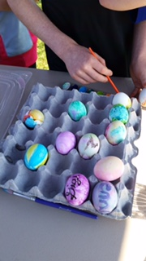
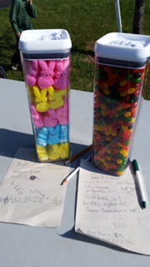
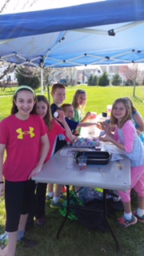
Easter Celebration

Slide 10
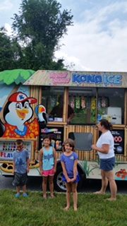
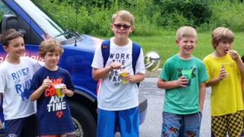
Last DAY OF SCHOOL

Slide 11
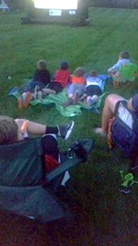
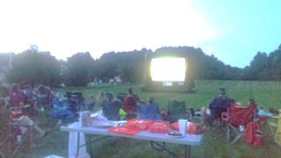
SUMMER MOVIE NIGHT

Slide 12
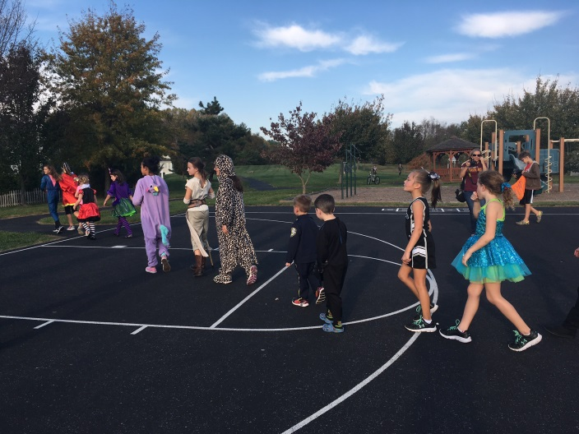
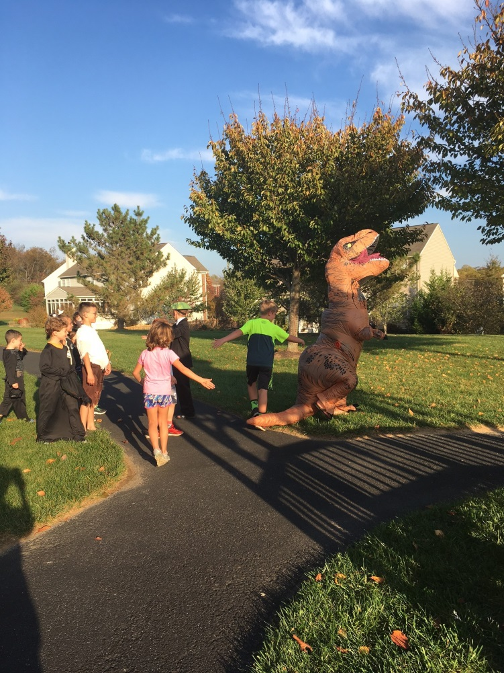
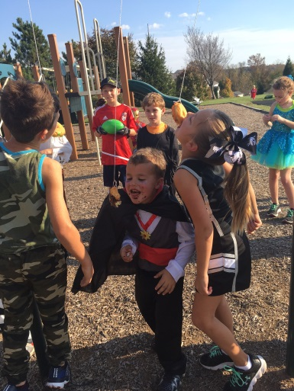
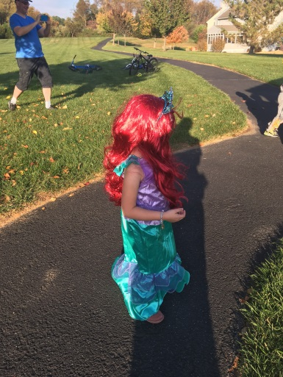
HALLOWEEN COSTUME CONTEST

Slide 13
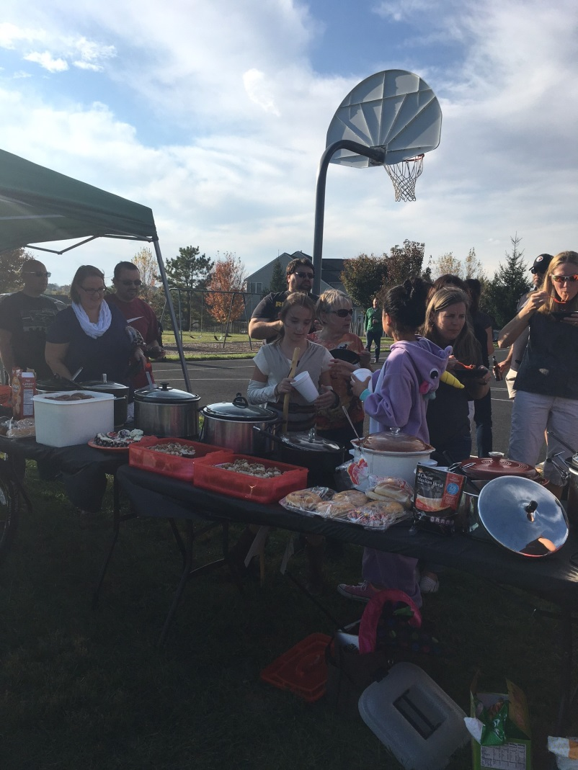
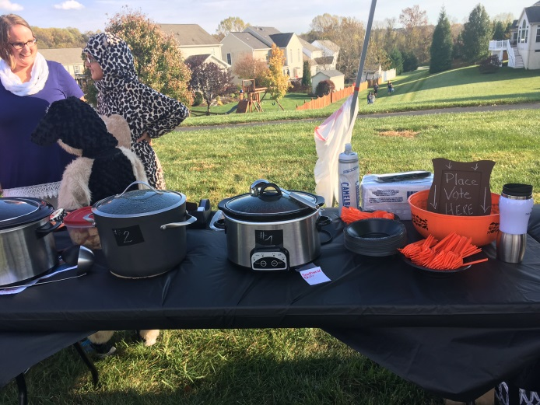
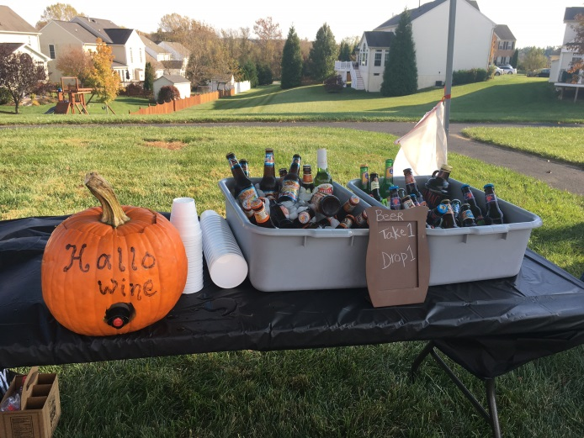
Chili Cook-off

Slide 14
Financial Management
Tidewater Property Management
Collect of HOA Dues
Pay Bills
Prepare Annual Budget (W/Board Direction)
Prepare Monthly Financial Statements
Prepare Balance Sheet
Procure Tax Preparation Services
Procure Property Insurance
Procure Legal Services
http://www.tidewaterproperty.com/

Slide 15
Financial Review
Budget 2016
Budget 2017
Revenues ($59,740)
103 Houses
$580/yr.
Expenses ($58,074)
Financial Mgmt. $6,180
Lawn Maint. $19,374
Waste Mgmt. $24,295
Remaining ($1,666)
Revenues ($59,740)
103 Houses
$580/yr.
Expenses ($58,074)
Financial Mgmt. $6,180
Lawn Maint. $20,500
Waste Mgmt. $25,000
Remaining ($0)
*Potential 2-3% increase in HOA Dues for 2018 ($10-$15)

Slide 16
Financial Statements
See Handouts

Slide 17
HOA Proxies and Voting
Change/Amend By-Laws
N/A
HOA Dues Increase (by more than 10%)
N/A
Special Assessments (For reasons other than damaged common area property, not covered by insurance)
N/A
HOA Board Members
TBD

Slide 18
1958 Andrew Ct
Abandoned 3-Years
Neighbor Complaints
Bank Owned
Wells Fargo
Auction 9/30/16 (Did not Sell)
After Sale Redemption Period
30-45 days
Real Estate Owned (REO) Website
https://reo.wellsfargo.com/
Hire Realtor

Slide 19
Questions?
HOA Topics Discussed
Purpose
Board Activities
Committee Activities
Financial Reporting
Voting Requirements
Please consider volunteering for a position on the HOA Board
HOA Website: http://jennaestates.weebly.com/
HOA Email: JennaHOA@gmail.com

