Slide 1
Jenna Estates MARCH 2, 2020
Annual HOA Meeting

Slide 2
About Jenna Estates
Est. 2001
103 Homes
Tot Lot
Basketball Court

Slide 3
About the HOA
Jenna Estates Homeowners Association, Inc. (HOA)
Legal Entity – Nonprofit Corporation
Est. 2001
HOA Purpose
Preserve value and amenities in the community
HOA Board Purpose
Collection and Disbursement of HOA Dues
Maintenance and Administration of Common Areas
Enforcement of Covenants and Restrictions, and By-Laws
HOA Website: jennaestates.weebly.com
HOA Email: JennaHOA@gmail.com

Slide 4
HOA Board and Committee Members
HOA Board
Alyssa Neumann (President)
Mark Neumann (Treasurer)
Beth Menendez (Secretary)
Scott Davis (Member at Large)
HOA Committees
Chris Karper (Architectural)
Kerry Fosko (Landscape)
Karena Wickersham (Social)
Perry King (Website)
Open Position
Vice President

Slide 5
Financial Review
Actual 2019
Budget 2020
Revenues $61,234
103 Houses
$580/yr.
Expenses $54,777
Financial Mgmt. $8,272
Lawn Maint. $21,086
Waste Mgmt. $24,308
Recreational $1,111
Remaining $6,457
Revenues $59,740
103 Houses
$580/yr.
Expenses $59,740
Financial Mgmt. $9,305
Lawn Maint. $22,769
Waste Mgmt. $25,000
Recreational $1,000
Remaining $1,666
Annual HOA Dues will increase by $14.50 (10%) per quarter or $58 per year on January 1st, 2021.
Notes:
2018 was a 3K deficit
2017 under 1K deficit
2,200 dollars a month for the Mows
Extra 600 dollars for a mow
6,100 per Quarter for Trash

Slide 6
Financial Statements
See Handouts
RESERVES
Currently Holding approx. $64.5K, maturing at different times for availability (if released early, typically pay a penalty on the interest that would have been earned for the rest of the term of the CD)
Potential do deplete a large portion with upcoming initiatives

Slide 7
Financial Management
Tidewater Property Management
Collect of HOA Dues
Pay Bills
Prepare Annual Budget (W/Board Direction)
Prepare Monthly Financial Statements
Prepare Balance Sheet
Procure Tax Preparation Services
Procure Property Insurance
Procure Legal Services
http://www.tidewaterproperty.com/

Slide 8
2020 HOA Projects
Erosion Issues
Prothero Road
Paved walking path to tot lot
Tot Lot Revitalization
Dead tree removal/replacement
Playground mulch
Stabilize monkey bars
Contract Negotiations
Landscaping
Trash/Recycling

Slide 9
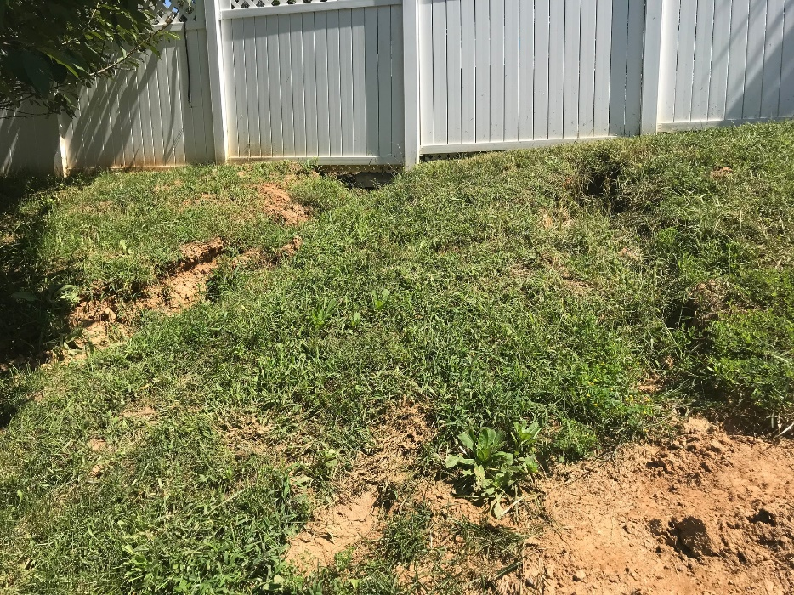
Erosion Problems
Prothero Road
Walking Path to Tot Lot

Slide 10
Landscape Committee: 2020 Plans
Spring Cleanup
Gazebo Roof Repair/Replacement
Entrance Lighting

Slide 11
Social Committee: 2020 Plans
Winter New Year Party
Spring Picnic & Easter Egg Hunt (Saturday, March 28)
Summer Event
Fall Halloween Costume Contest and Chili Cook-Off

Slide 12
HOA Proxies and Voting
HOA Board Member – Vice President
TBD
Change/Amend By-Laws
N/A
HOA Dues Increase (by more than 10%)
N/A
Special Assessments (For reasons other than damaged common area property, not covered by insurance)
N/A

Slide 13
Questions
HOA Topics Discussed
Purpose
Board Activities
Committee Activities
Financial Reporting
Voting Requirements
Please consider volunteering for a position on the HOA Board or HOA Committee
HOA Website: jennaestates.weebly.com
HOA Email: JennaHOA@gmail.com

