Slide 1
Jenna Estates February 27, 2018
Annual HOA Meeting

Slide 2
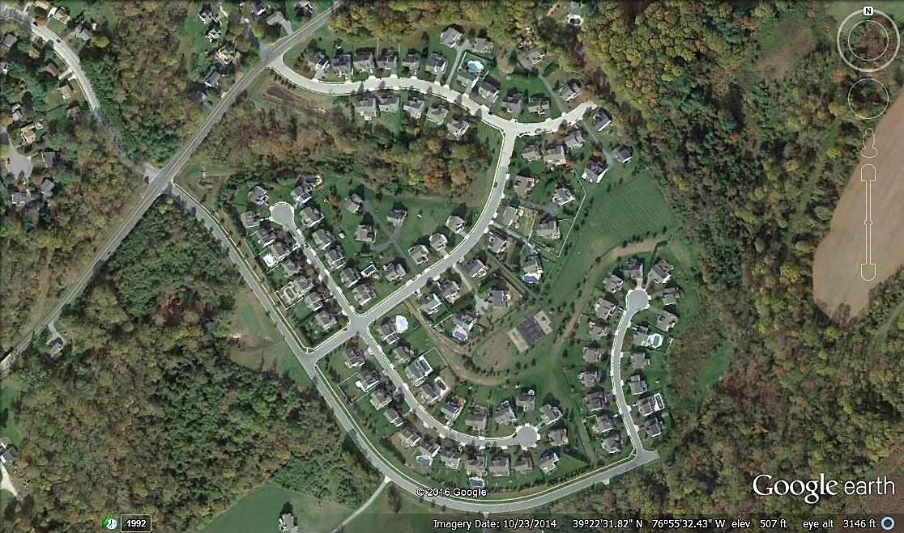
Est. 2001
103 Homes
Tot Lot
Basketball Court

Slide 3
About the HOA
Jenna Estates Homeowners Association, Inc. (HOA)
Legal Entity – Nonprofit Corporation
Est. 2001
HOA Purpose
Preserve value and amenities in the community
HOA Board Purpose
Collection and Disbursement of HOA Dues
Maintenance and Administration of Common Areas
Enforcement of Covenants and Restrictions, and By-Laws
HOA Website: http://jennaestates.weebly.com/
HOA Email: JennaHOA@gmail.com

Slide 4
HOA Board and committee members
HOA Board
Beth Menendez (Secretary)
Rob Moseman (Treasurer, term ends 2018)
Ron Prietz (President, term ends 2018)
Scott Davis (Member at Large)
HOA Committees
Kerry Fosko (Landscape)
Open Positions
Starting 2019 (President)
Immediate Opening (Vice President)
Starting 2019 (Treasurer)
Immediate Opening (Social Committee)
Immediate Opening (Architectural Committee)

Slide 5
HOA Board
2017 Activities
2018 Future Plans
Financial Management
Contract extended for 2018
Landscaping
3yr Contract thru 2019
Waste Management
3yr Contract thru 2019
Monthly Planning Meetings
meeting minutes on file
Architectural Reviews
Walking Path Repairs
Missing Shutter Letters
Dirt Bike Letter
Monthly Planning Meetings
Landscape Lighting at Front Entrances
Tot Lot Maintenance & Repairs
Gazebo Roof Repairs

Slide 6
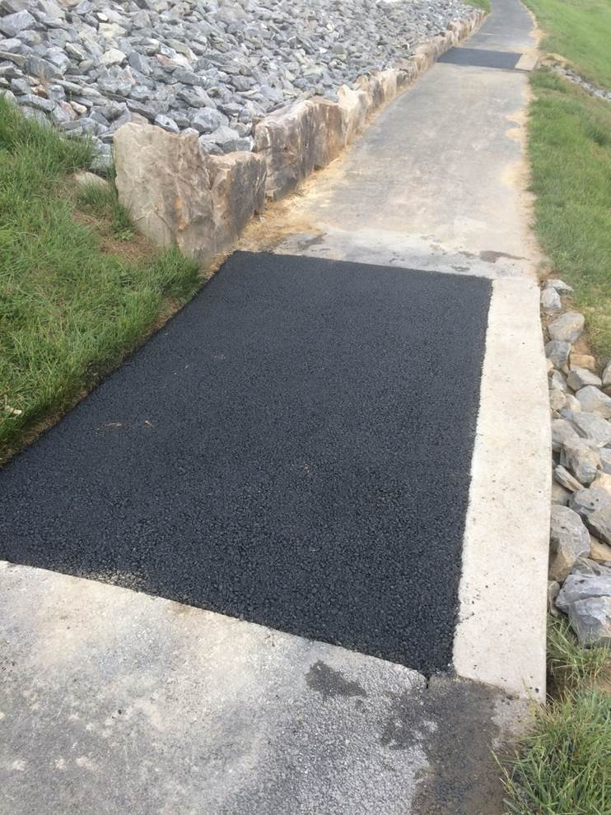
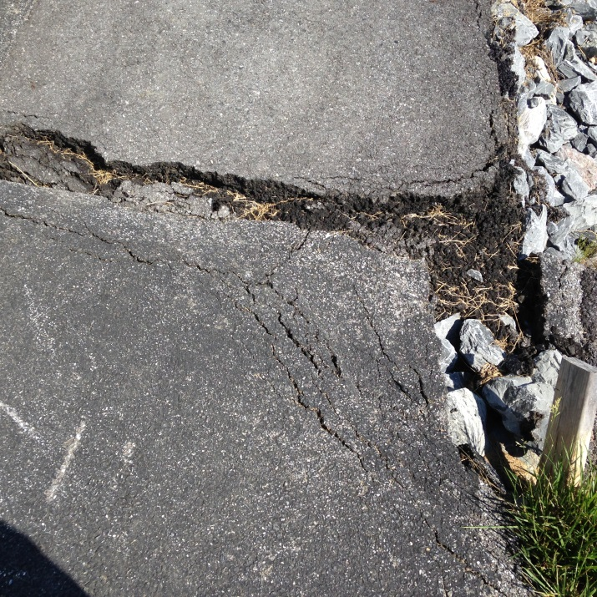
Walkway Repairs
Before
After

Slide 7
Landscape Committee
2017 Activities
2018 Future Plans
Lawn Maintenance
3yr Contract thru 2019
Spring Cleanup
Neighborhood Volunteers
30-yard recycling container
Playground Mulch
Spring Cleanup
Gazebo Roof Repairs
Landscape Lighting at Front Entrance

Slide 8
Social Committee
2017 Activities
2018 Future Plans
Summer BBQ
Fall Halloween Costume Contest and Chili Cook-Off
Need Volunteers for Social Committee

Slide 9
Financial Management
Tidewater Property Management
Collect of HOA Dues
Pay Bills
Prepare Annual Budget (W/Board Direction)
Prepare Monthly Financial Statements
Prepare Balance Sheet
Procure Tax Preparation Services
Procure Property Insurance
Procure Legal Services
http://www.tidewaterproperty.com/

Slide 10
Financial Review
Actual 2017
Budget 2018
Revenues $60,919
103 Houses
$580/yr.
Expenses $61,155
Financial Mgmt. $6,180
Lawn Maint. $32,300
Waste Mgmt. $18,640
Remaining ($236)
Revenues $59,740
103 Houses
$580/yr.
Expenses $59,740
Financial Mgmt. $6,180
Lawn Maint. $23,119
Waste Mgmt. $25,000
Remaining $0

Slide 11
Financial Statements
See Handouts

Slide 12
HOA Proxies and Voting
Change/Amend By-Laws
N/A
HOA Dues Increase (by more than 10%)
N/A
Special Assessments (For reasons other than damaged common area property, not covered by insurance)
N/A
HOA Board Members
TBD

Slide 13
Questions?
HOA Topics Discussed
Purpose
Board Activities
Committee Activities
Financial Reporting
Voting Requirements
Please consider volunteering for a position on the HOA Board or HOA Committee
HOA Website: http://jennaestates.weebly.com/
HOA Email: JennaHOA@gmail.com

