Slide 1
Jenna Estates FEBRUARY 9, 2021
Annual HOA Meeting

Slide 2
About Jenna Estates
Est. 2001
103 Homes
Tot Lot
Basketball Court

Slide 3
About the HOA
Jenna Estates Homeowners Association, Inc. (HOA)
Legal Entity – Nonprofit Corporation
Est. 2001
HOA Purpose
Preserve value and amenities in the community
HOA Board Purpose
Collection and Disbursement of HOA Dues
Maintenance and Administration of Common Areas
Enforcement of Covenants and Restrictions, and By-Laws
HOA Website: jennaestates.weebly.com
HOA Email: JennaHOA@gmail.com

Slide 4
HOA Board and Committee Members
HOA Board
Alyssa Neumann (President)
Mark Neumann (Treasurer)
Suzanne Justus (Secretary)
Scott Davis (Member at Large)
HOA Committees
Chris Karper (Architectural)
Steve Sullivan (Landscape)
Karena Wickersham (Social)
Perry King (Communications/Website)
Open Position
Vice President

Slide 5
Financial Review
Actual 2020
Budget 2021
Revenues $61,248
103 Houses
$580/yr.
Expenses $54,189
Financial Mgmt. $12,107
Lawn Maint. $22,459
Waste Mgmt. $18,971
Recreational $652
Net Income $7,059
Waste Management Expense would reduce net income to ~$1K
Revenues $65,714
103 Houses
$638/yr.
Expenses $68,056
Financial Mgmt. $9,056
Lawn Maint. $27,000
Waste Mgmt. $31,000
Recreational $1,000
Net Loss ($2,342)
Waste Management Expense shift would result in a net income of ~$3,735
As of January 1st, 2021, the annual HOA dues increased by $14.50 (10%) per quarter or $58 per year.
Notes:
For those with auto draft, please adjust auto draft amount.

Slide 6
2020 Completed HOA Projects
Erosion Related ($23,150)
Prothero Road: Installed riprap, reseeded
Hill along paved walking path to tot lot: Regraded, installed riprap, planted grass, repaired path
Aeration and overseeding
Tot Lot
Removed dead trees ($1,850)
Replaced gazebo roof and painted ($1,479)
Entrance Lighting: Installed solar up lights at each entrance ($95)
Contract: 3-year Landscaping agreement with Bob Jackson (‘21 – ‘23)

Slide 7
2021 HOA Planned Projects
Erosion Related
Prothero Road: Investigate alternative ground covering
Hill along paved walking path to tot lot: Investigate other solutions for storm water management
Victory Hill Way: Investigate remedies for sinking sidewalk tiles
Tot Lot (March/April)
Install New Playground ($16,589)
Replace wood boxes around each play area and mulch ($4,590)

Slide 8
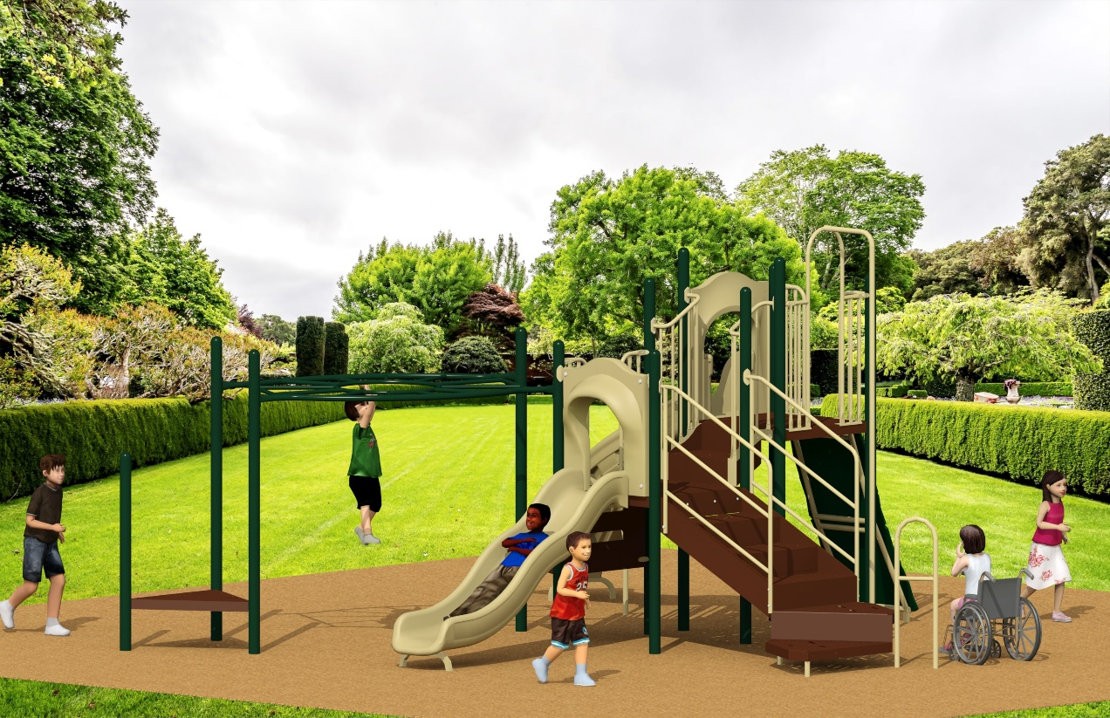
2021 HOA Projects: New Playground

Slide 9
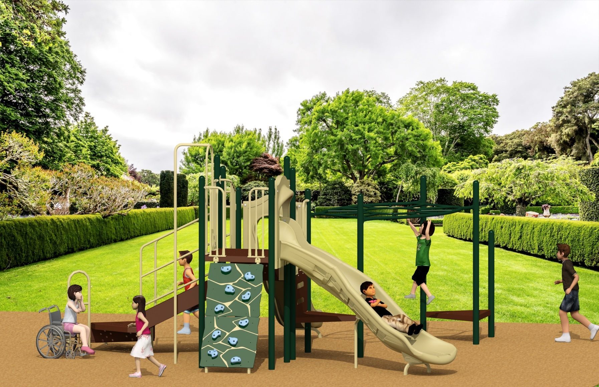
2021 HOA Projects: New Playground

Slide 10
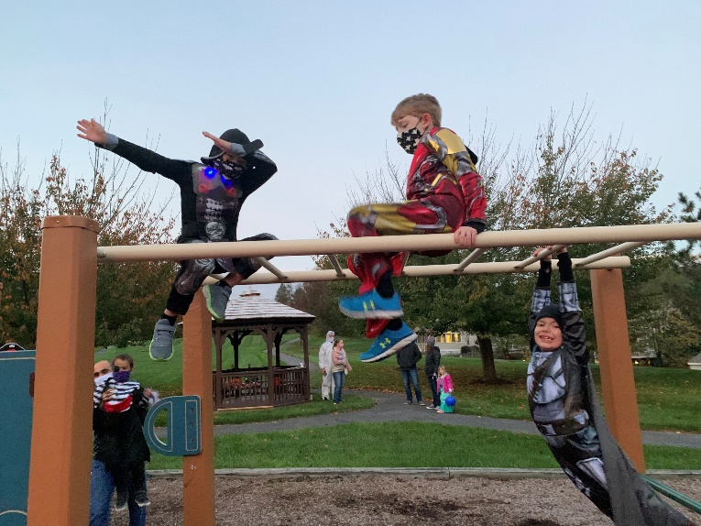
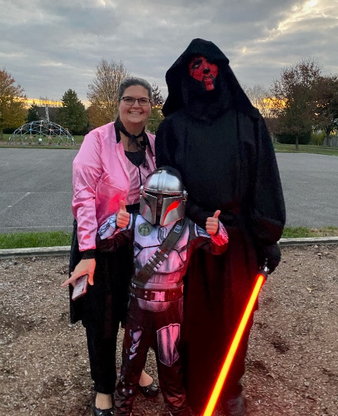
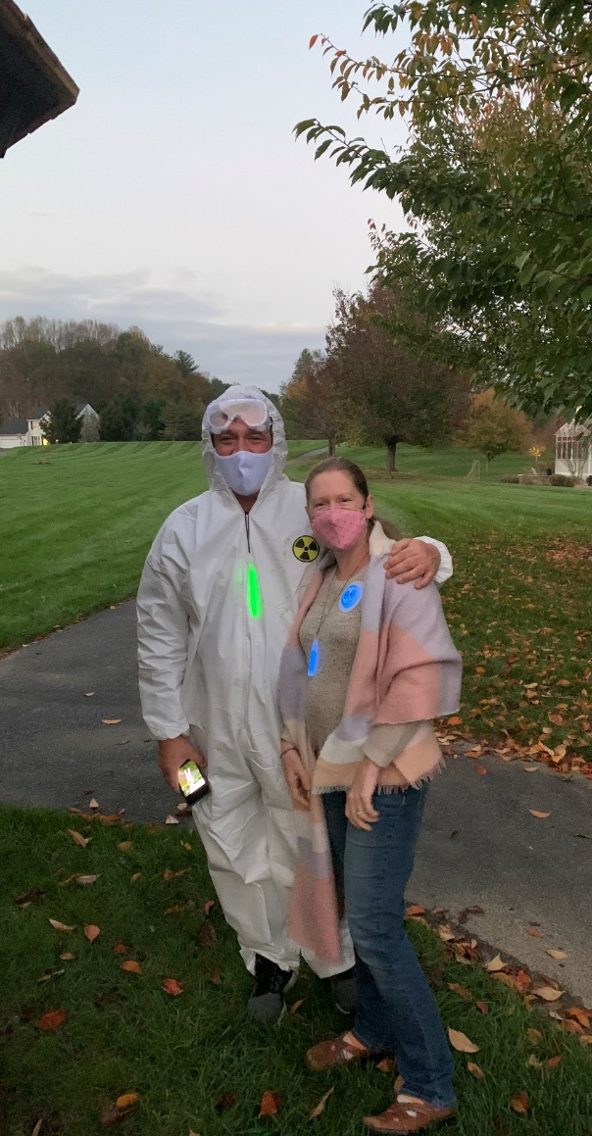
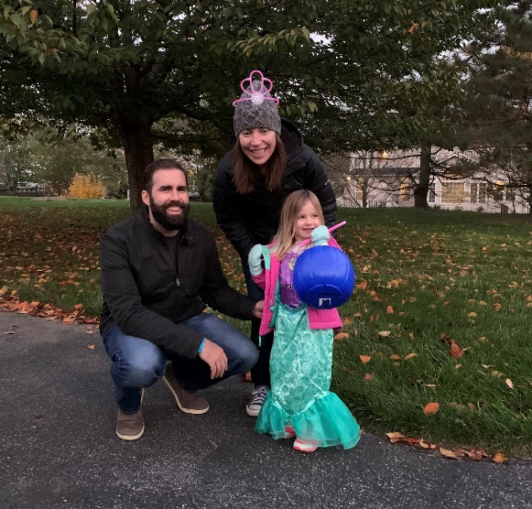
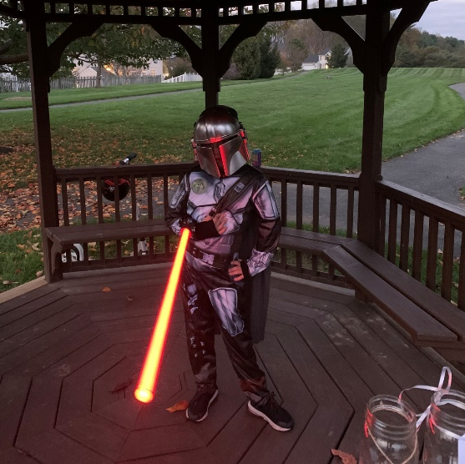
Social Committee: 2020 Halloween Event

Slide 11
Social Committee: 2021 Plans
We are hoping to have a couple socially distant, COVID safe events, but everything is TBD.
Potential Events Include:
May 15th: Spring Clean Up and Planting
June 16th: Last Day of School Celebration with Kona Ice Truck
September 4th: Back to School Outdoor Movie at Tot Lot
October: Halloween Costume and Jack-o-lantern Contest

Slide 12
HOA Proxies and Voting
HOA Board Member and Committee Chair
Secretary – Suzie Justus
Landscape Committee Chair – Steve Sullivan
Change/Amend By-Laws
N/A
HOA Dues Increase (by more than 10%)
N/A
Special Assessments (For reasons other than damaged common area property, not covered by insurance)
N/A

Slide 13
Questions
Please consider volunteering for a position
Vice President: Act as President in the President’s absence
Attend all meetings of the Members and the Board and see that orders/resolutions of the Board are carried out.
Visit the HOA Website: jennaestates.weebly.com
Contact the HOA Board: JennaHOA@gmail.com
Visit the Tidewater Property Management Website: http://www.tidewaterproperty.com/

