Slide 1
Jenna Estates
JANUARY 8, 2019
Annual HOA Meeting

Slide 2
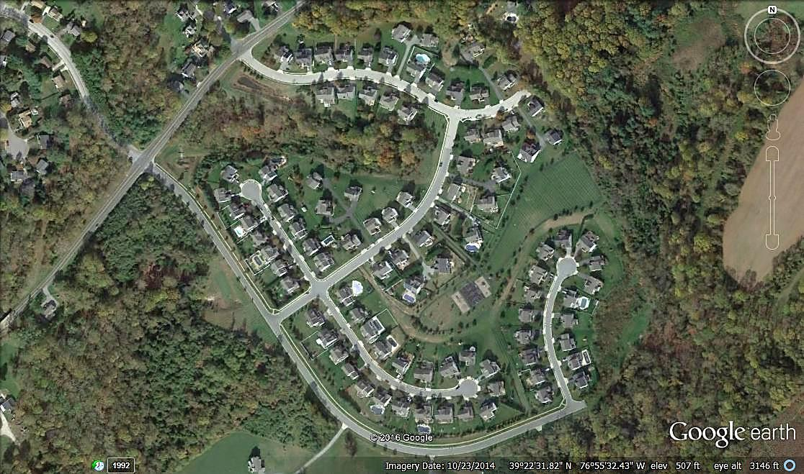
Est. 2001
103 Homes
Tot Lot
Basketball Court

Slide 3
About the HOA
Jenna Estates Homeowners Association, Inc. (HOA)
  Legal Entity – Nonprofit Corporation
  Est. 2001
HOA Purpose
  Preserve value and amenities in the community
HOA Board Purpose
  Collection and Disbursement of HOA Dues
  Maintenance and Administration of Common Areas
  Enforcement of Covenants and Restrictions, and By-Laws
HOA Website: http://jennaestates.weebly.com/
HOA Email: JennaHOA@gmail.com

Slide 4
HOA Board and committee members
HOA Board
  Beth Menendez (Secretary)
  Rob Moseman (Treasurer, term ends 2018)
  Ron Prietz (President, term ends 2018)
  Scott Davis (Member at Large)
HOA Committees
  Chris Karper (Architectural)
  Karena Wickersham (Social)
  Kerry Fosko (Landscape)
Open Positions
  Immediate Opening (President)
  Immediate Opening (Vice President)
  Immediate Opening (Treasurer)

Slide 5
HOA Board
2018 Activities
2019 Future Plans
Contract Management
  Financial Management
  Landscaping
  Waste Management
Monthly Planning Meetings
  meeting minutes on file
Missing Shutter Letters
Sidewalk Repairs
Tot Lot Equipment Repairs
Contract Management
  Negotiate
    Financial Management
  Compete New Contracts
    Landscaping
    Waste Management
Monthly Planning Meetings
  meeting minutes on file
Landscape Lighting
Gazebo Roof Replacement
Tot Lot Equipment Repairs

Slide 6
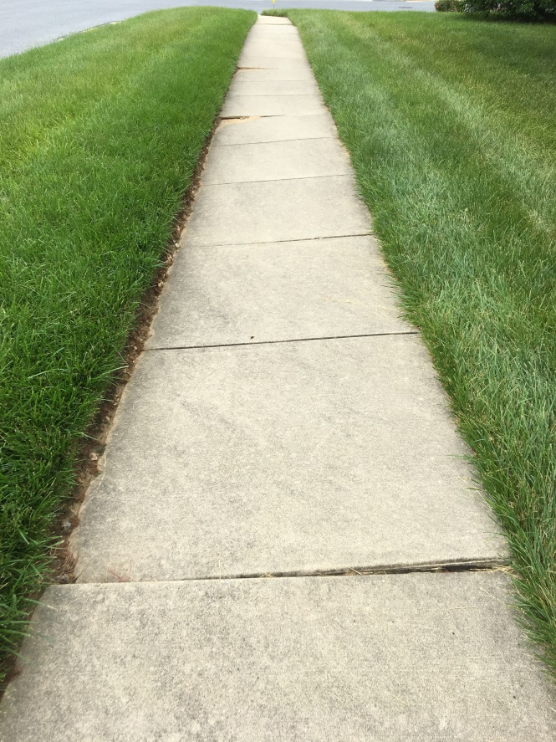
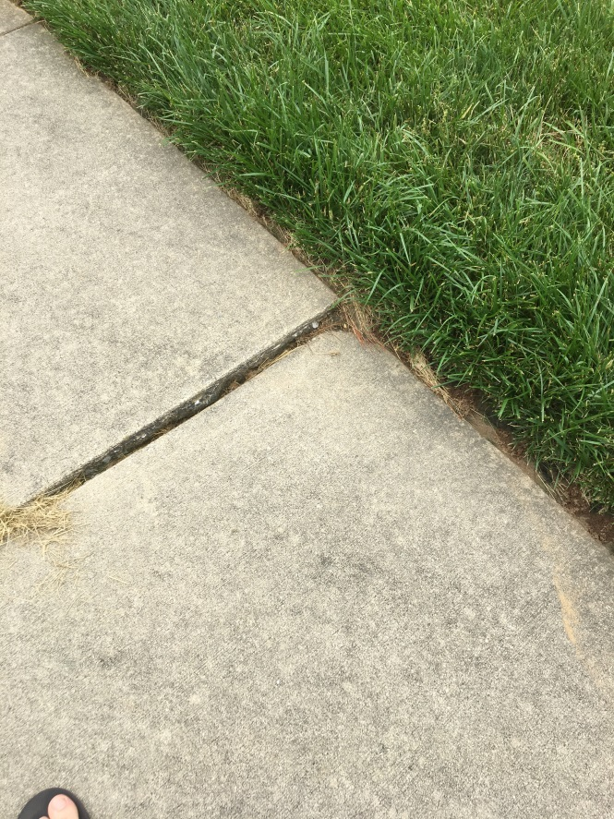
Sidewalk Repairs
Before
Before

Slide 7
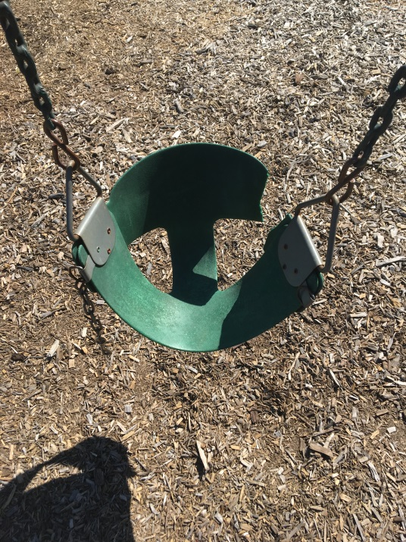
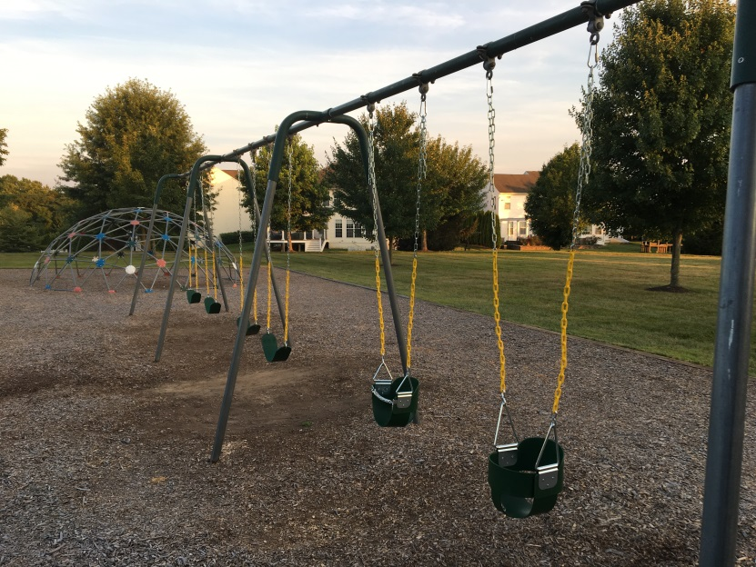
Tot Lot Repairs
Before
After

Slide 8
Landscape Committee
2018 Activities
2019 Future Plans
Contract Management
  Lawn Maintenance
Tree Trimming
  Victory Hills Entrance
  Tot Lot Area
Spring Cleanup
Erosion Problems
Tree Trimming
  Prothero Hill (right side)
  Tot Lot Area

Slide 9
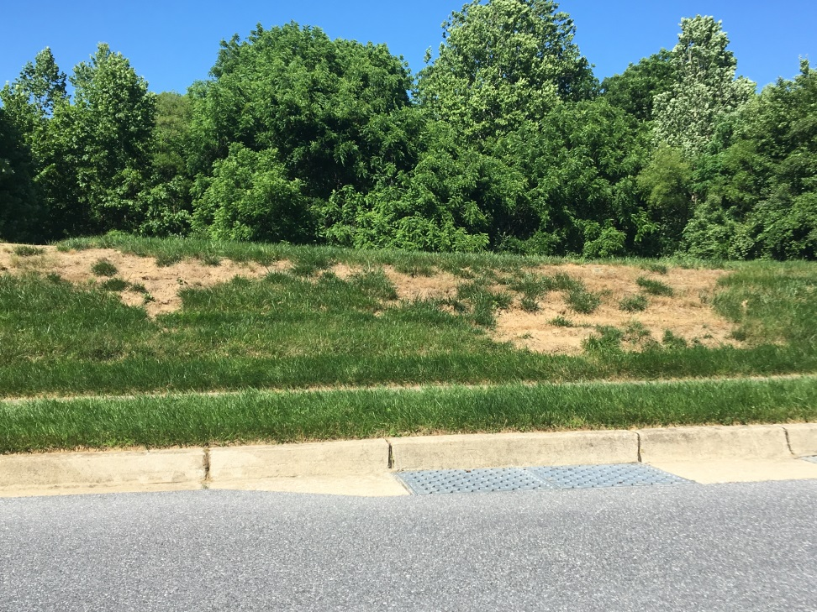
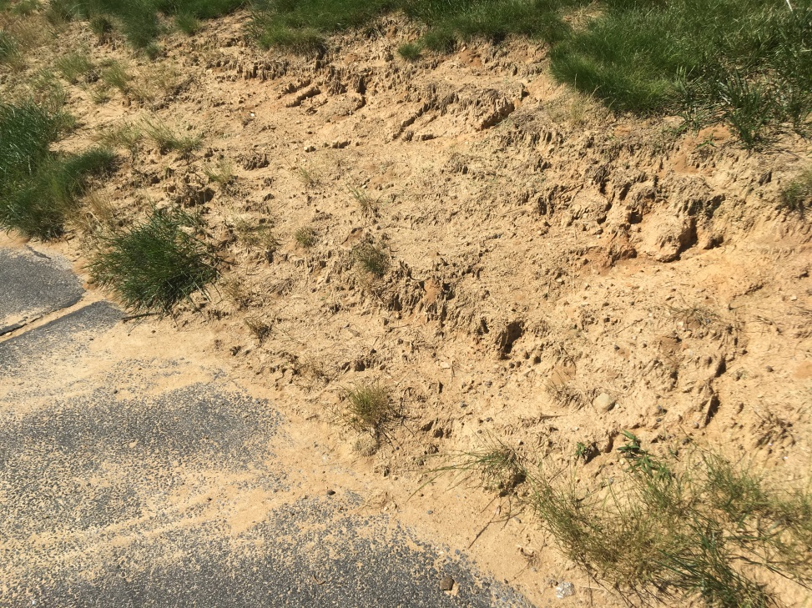
Erosion Problems
Prothero Entrance
Walking Path to Tot Lot

Slide 10
Social Committee
2018 Activities
2019 Future Plans
Spring Easter Egg Hunt
Fall Halloween Costume Contest and Chili Cook-Off
Winter New Year Party
Spring Easter Egg Hunt
Summary BBQ
Fall Halloween Costume Contest and Chili Cook-Off

Slide 11
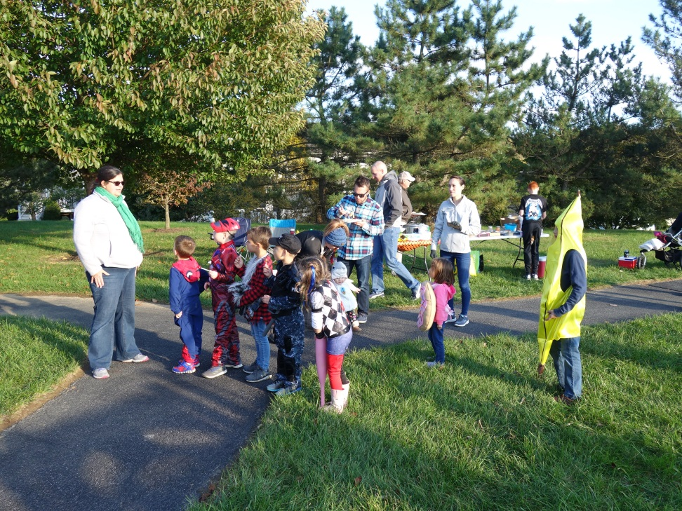
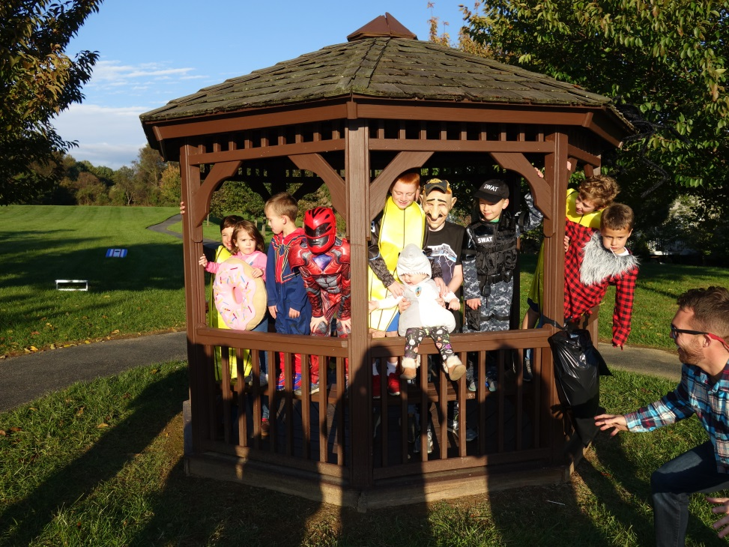
Social Events
Fall Party
Fall Party

Slide 12
ARCHITECTURAL Committee
2018 Approvals
2018 Approvals
1911 Robby Ct
  New Fence
1952 VHW
  New Fence
7313 Falling Leaves Ct
  Deck Replacement
7220 Shub Farm Rd
  New Concrete Patio
1933 VHW
  New Shed
7209 Shub Farm Rd
  Roof & Windows Replacement
1913 Robby Ct
  New Fence
1930 VHW
  New Basement Door and Patio Replacement

Slide 13
Financial Management
Tidewater Property Management
  Collect of HOA Dues
  Pay Bills
  Prepare Annual Budget (W/Board Direction)
  Prepare Monthly Financial Statements
  Prepare Balance Sheet
  Procure Tax Preparation Services
  Procure Property Insurance
  Procure Legal Services
http://www.tidewaterproperty.com/

Slide 14
Financial Review
Actual 2018
Budget 2019
Revenues $61,147
  103 Houses
  $580/yr.
Expenses $63,860
  Financial Mgmt. $6,180
  Lawn Maint. $23,869
  Waste Mgmt. $24,308
Remaining ($2713)
Revenues $59,740
  103 Houses
  $580/yr.
Expenses $59,740
  Financial Mgmt. $6,180
  Lawn Maint. $20,500
  Waste Mgmt. $25,000
Remaining $0

Slide 15
Financial Statements
See Handouts

Slide 16
HOA Proxies and Voting
Change/Amend By-Laws
  N/A
HOA Dues Increase (by more than 10%)
  N/A
Special Assessments (For reasons other than damaged common area property, not covered by insurance)
  N/A
HOA Board Members
  TBD

Slide 17
Questions?
HOA Topics Discussed
  Purpose
  Board Activities
  Committee Activities
  Financial Reporting
  Voting Requirements
Please consider volunteering for a position on the HOA Board or HOA Committee
HOA Website: http://jennaestates.weebly.com/
HOA Email: JennaHOA@gmail.com

